Slide 1
Real-Time Product/Service Sentiment Monitor
Sung Bae
Data Scientist | Data Analyst | Educator | Problem Solver

Slide 2
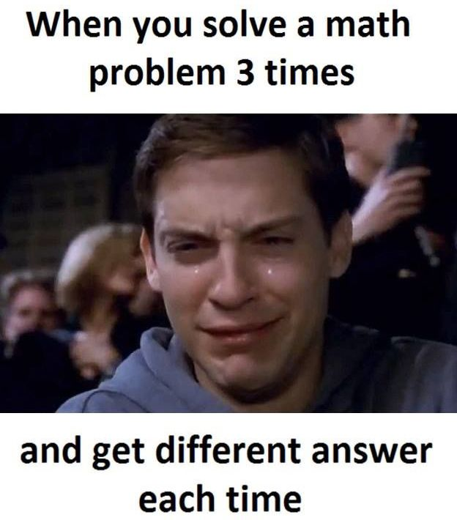

Notes:
http://clipart-library.com/teacher-student-cliparts.html

Slide 3
When you talk,
you are only repeating
what you already know.
But if you listen,
you may learn
something new.
Dalai Lama XIV
Notes:
camilo jimenez
https://unsplash.com/photos/qZenO_gQ7QA
https://www.mobilecon2012.com/the-evolution-of-communication-through-the-centuries/

Slide 4

How do big companies listen to all their users/customers?
Notes:
Source: https://www.lynda.com/HootSuite-tutorials/What-you-should-know-about-social-listening/546104/621981-4.html

Slide 5
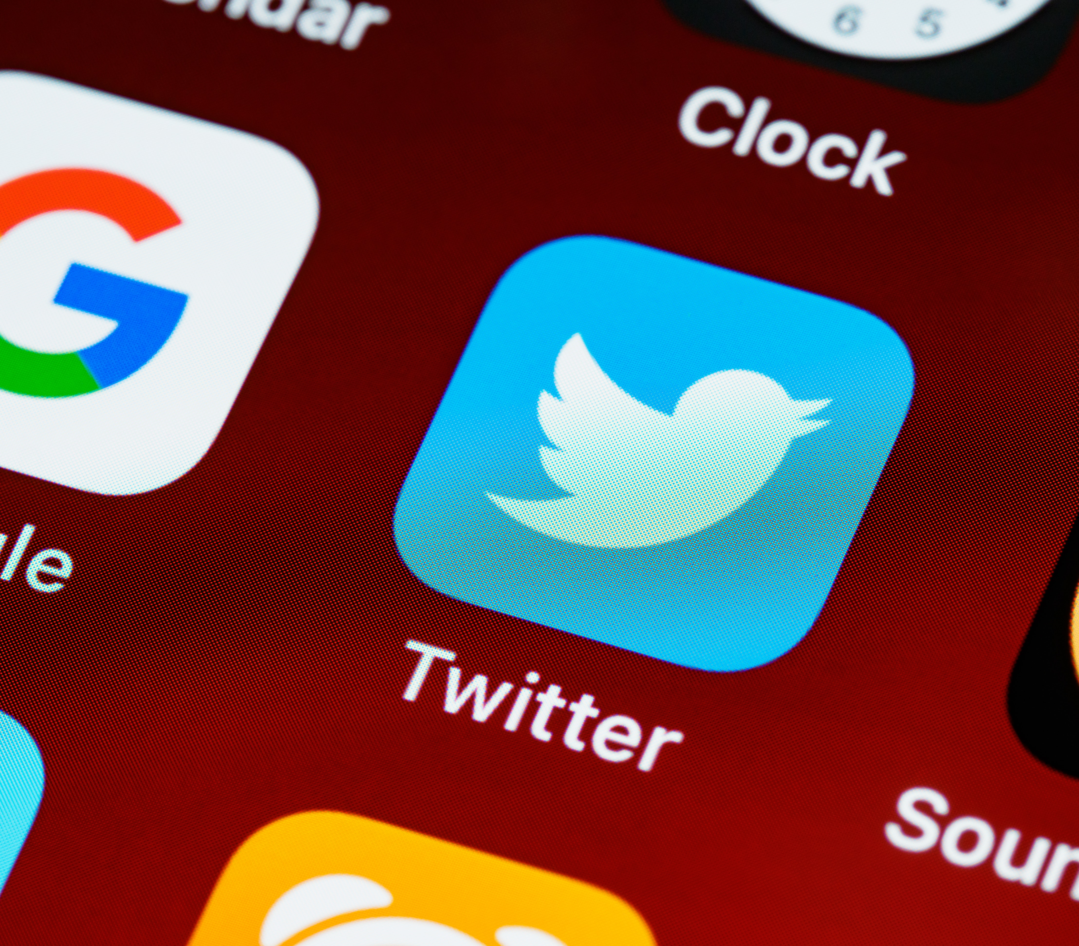
WHY Twitter?
145 million daily users
22% of Americans are on Twitter
500 million tweets sent each day
65.8% of US companies use Twitter for marketing
80% of Twitter users have mentioned a brand in a tweet
77% of Twitter users feel more positive when their tweet has been replied to.
Notes:
https://unsplash.com/photos/ulRlAm1ITMU

Slide 6




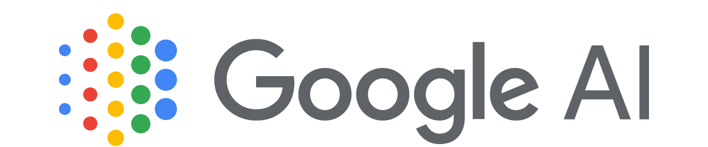

Technologies
Bidirectional Encoder Representations from Transformers (BERT)
Valence Aware Dictionary and sEntiment Reasoner (VADER)

Slide 7
Challenges
Creating and organizing graphs and tables so that they are readable and attractive
Creating WordCloud images that are meaningful
Organizing SQL database in an efficient way

Slide 8
THANK YOU! – Questions?
Dashboard Info
https://github.com/singsang2/capstone-twitter-analysis
Contact Info
Gmail: hello.sungbae@gmail.com
LinkedIn: https://www.linkedin.com/in/sunghoonbae/
GitHub: https://github.com/singsang2/

